Slide 1
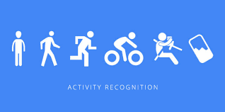
HUMAN ACTIVITY RECOGNITION USING SMART PHONES

Slide 2

DATA DYNASTY GROUP MEMBERS
Saurabh Verma (U09956219)
Nikita Gill (U49022008)
Janhavi Kharmale (U30004934)
Neha Satpute (U19160274)
Abhijit Wayal (U09616725)

Slide 3
AGENDA
Introduction
Business Opportunities
Past work
Data Description
Data Preprocessing and Modeling
Data Insights
Results

Slide 4
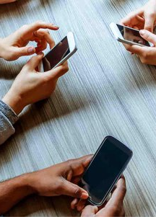
INTRODUCTION
In the contemporary world, smartphones have evolved into indispensable companions, appealing to individuals of all ages, spanning from the youth to the middle-aged and even the elderly. Beyond their conventional utility, smartphones have emerged as powerful tools for data collection and daily activity monitoring.
In this project, we've engineered a robust activity recognition system harnessing the omnipresence of smartphones. These devices, already deeply integrated into people's lives, serve as ideal instruments for our innovative approach. Our project offers remarkable potential for advancing Human Activity Recognition (HAR) applications, particularly within the domains of medical research and human survey systems.

Slide 5

BUSINESS OPPORTUNITIES
Health Monitoring Platforms: There's an opportunity to create platforms that use this ML model to offer daily, weekly, or monthly reports on user activity. These could be useful for users themselves or their healthcare providers to monitor health trends over time. The platform could provide insights into activity levels, predict potential health risks, and suggest preventive measures.
Elderly and Patient Care Solutions: In the healthcare sector, particularly in elderly care, the model can be employed in monitoring devices. These devices can be used in homes or care facilities to ensure the safety of individuals who require constant observation. By analyzing the activity data, caregivers can be alerted to any unusual patterns that might indicate a fall or a medical emergency.

Slide 6

PAST WORK
The research paper titled “Human Activity Recognition Using Smartphones" published in The Journal of "Iowa State University” introduced machine learning algorithm for providing predictions.
Two approaches in preprocessing :
With Principle Component Analysis
Without Principle Component Analysis
Used “Accuracy” of the model as the primary evaluation metric.
Used Machine Learning models like SVC, KNN and decision trees and compared the accuracy.
SVC proved to be better performing.

Slide 7
DATA DESCRIPTION
The dataset was collected from 30 individuals, referred to as "subjects" in this dataset, who wore smartphones attached to their waists while performing various activities. Total 563 features including the Subject and Activity. Each row identifies the subject who performed the activity for each window sample. Its range is from 1 to 30. Using the sensors, the dataset captures two main types of signals: '3-axial linear acceleration' (tAcc-XYZ) from the accelerometer and '3-axial angular velocity' (tGyro-XYZ) from the gyroscope.
Predictor Variables
Body and Gravity acceleration signals - tBodyAcc-XYZ and tGravityAcc-XYZ2
Body linear acceleration and Angular velocity were derived in time to obtain jerk signals - tBodyAccJerk-XYZ and tBodyGyroJerk-XYZ3
3-dimensional signals - tBodyAccMag, tGravityAccMag, tBodyAccJerkMag, tBodyGyroMag and tBodyGyroJerkMag
Frequency domain signals - fBodyAcc-XYZ, fBodyGyroMag

Slide 8
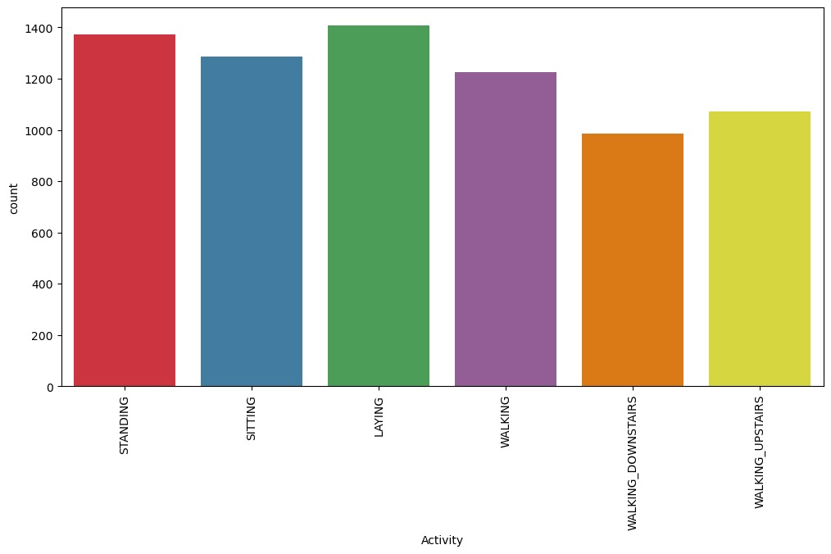
TARGET VARIABLE
Multiclass variable
WALKING
STANDING
LAYING
WALKING UPSTAIRS
WALKING DOWNSTAIRS
SITTING

Slide 9
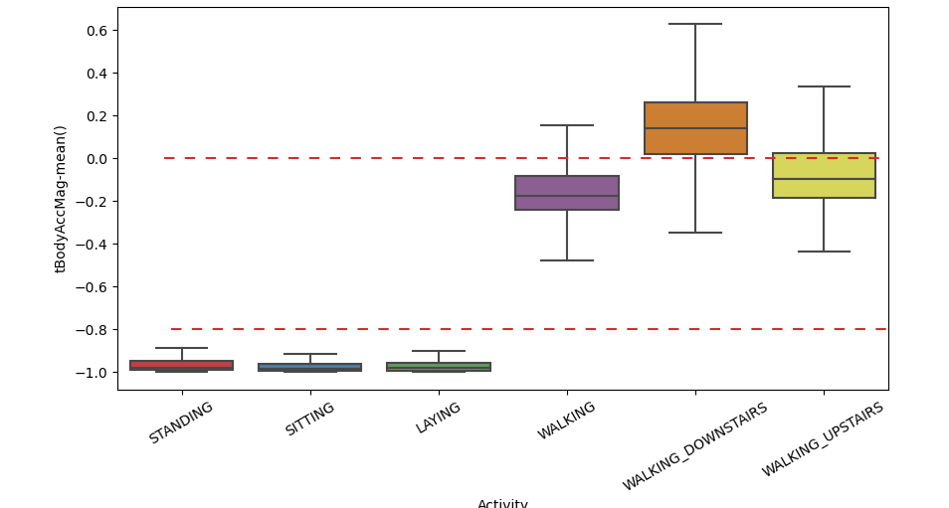
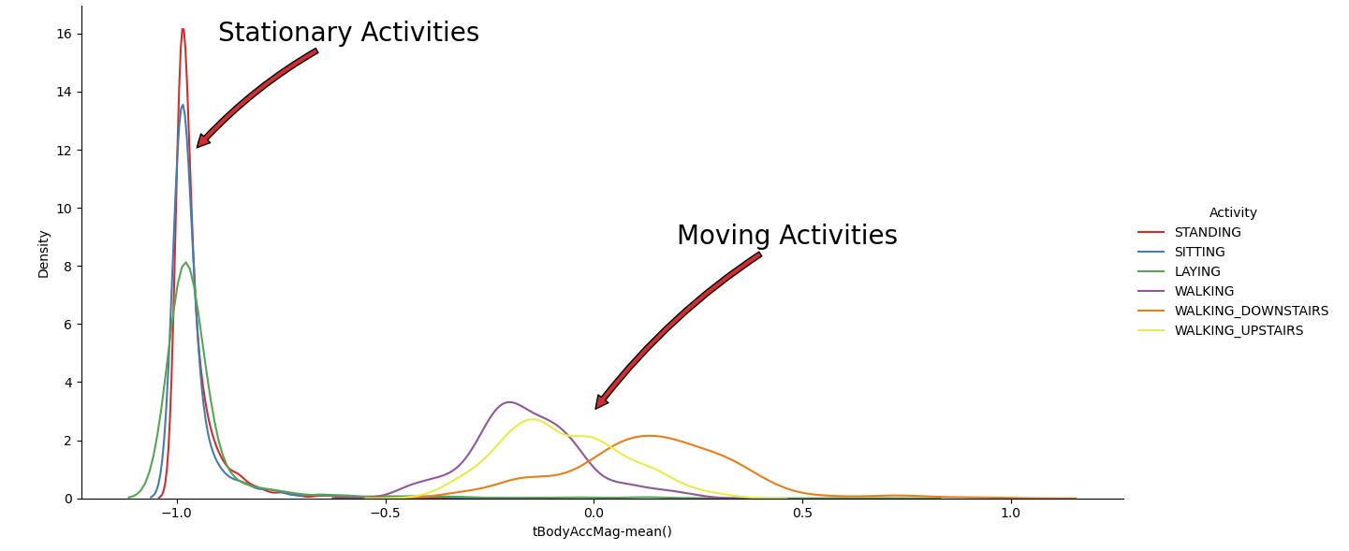
DATA INSIGHTS
As we can clearly see the difference between stationary activities and Moving Activities
"tBodyAccMag-mean" essentially represents the average magnitude of body acceleration over a certain time window or interval. It captures the intensity or strength of the body's movement during a particular activity.

Slide 10
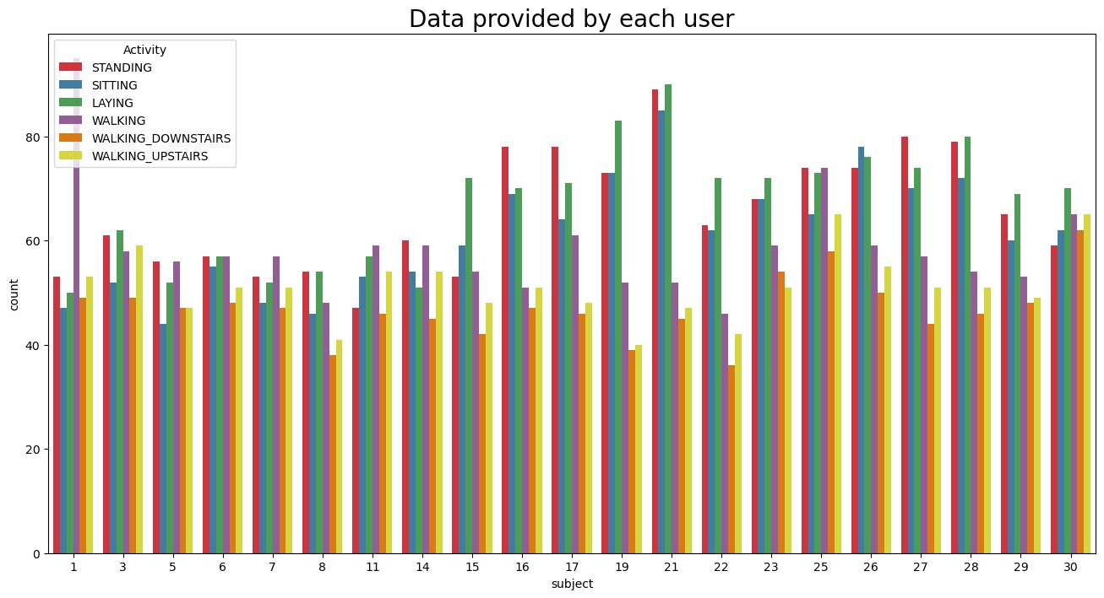
We possess data for all subjects across all six distinct activity categories, including standing, walking, and others.

Slide 11
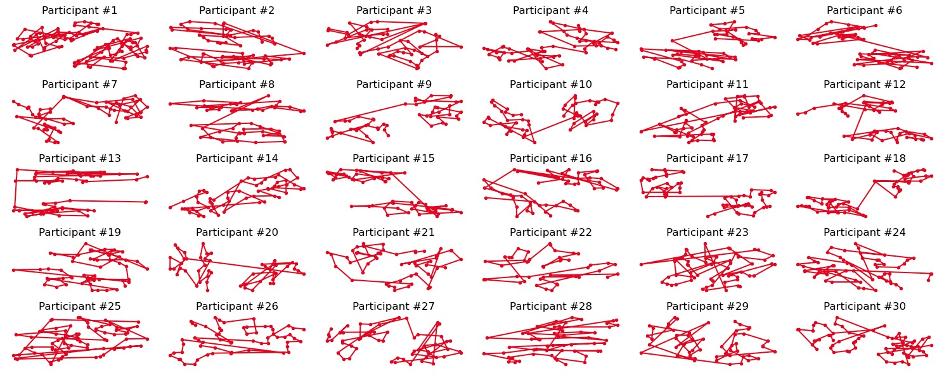
Visualizing the subjects' walking patterns in relation to sensor data, it becomes evident that each subject exhibits a unique and somewhat random walking pattern. However, there are instances of outliers or noise, like participant #3, whose walking pattern appears to be a linear line – a scenario that is not practically feasible.
Unique Walking Styles for each subject

Slide 12
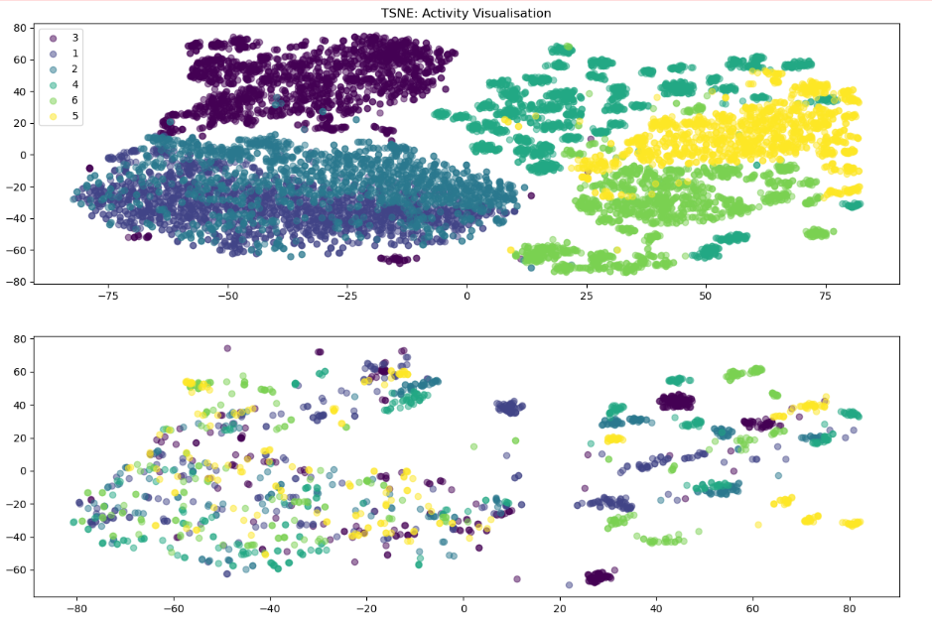
This clearly shows the activities are mostly separable.
This reveals personal information of the participants. Everybody has for example a unique/sparable walking style

Slide 13
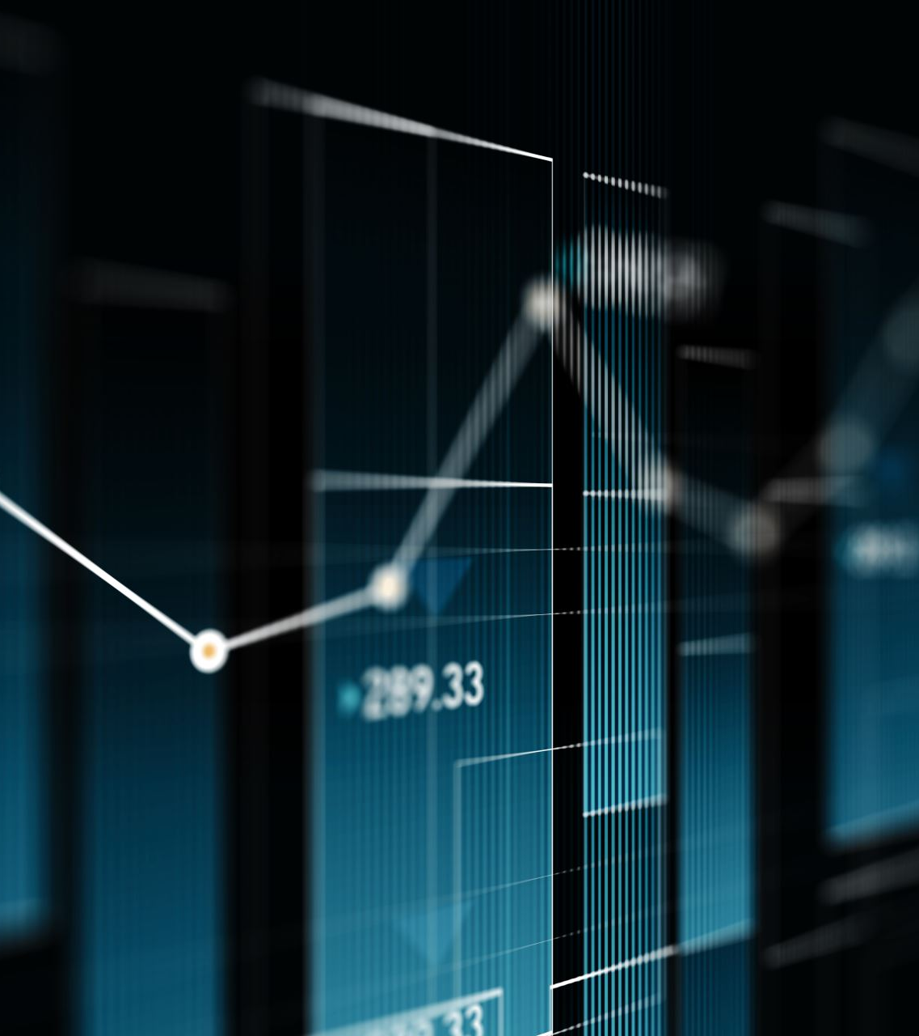
DATA PREPROCESSING AND MODELING
Load The Data To Your Ipynb File
Perform The Pre-processing
Split The Dataset Into Train And Test
Scaling
Fit The Base Model
Hyperparameter Tuning
Evaluating Metrics
Visualizing The Performance Metrics
Observations
Conclusion

Slide 14
MODELS USED FOR PREDICTION
AdaBoost
Naive Bayes
Decision Tree
KNN
Random Forest
MLP Classifier
XGBoost
SVM
Logistic Regression

Slide 15
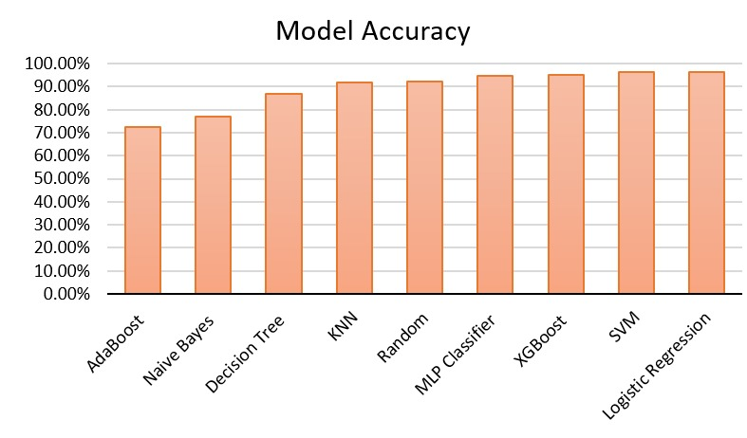
RESULTS

Slide 16
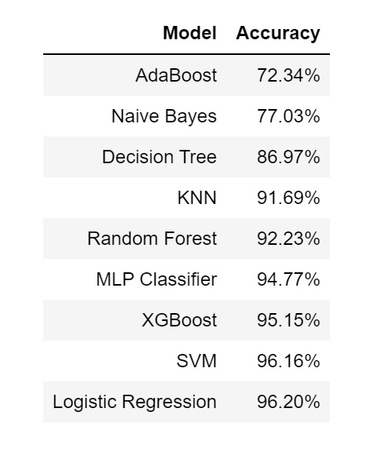
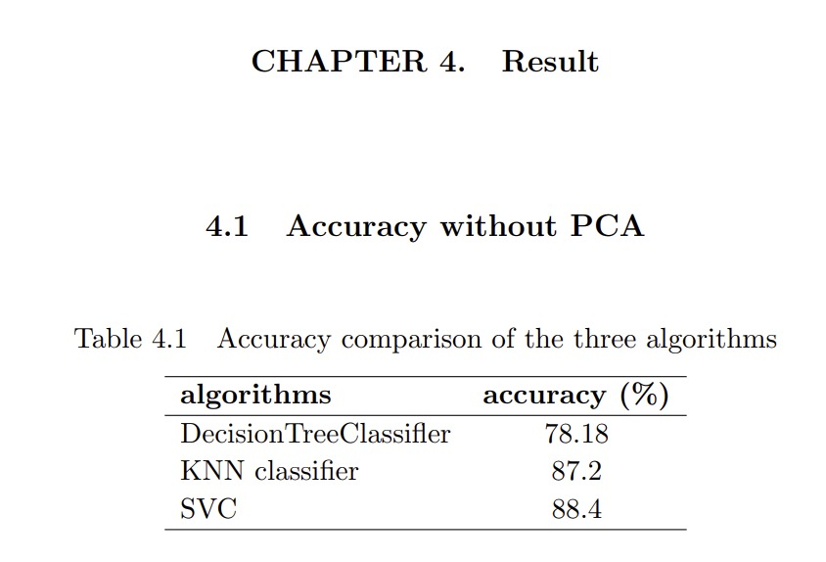
COMPARING RESULTS WITH PAST WORK

Slide 17
CONCLUSION
We compared the performance of various machine learning models, such as AdaBoost, Naive Bayes, Decision Tree, KNN, Random Forest, MLP Classifier, XGBoost, SVM, and Logistic Regression.
SVM, Logistic Regression and XGBoost emerged as the top-performing models, achieving an accuracy of 96.16% , 96.20% and 95.15% respectively.
Our models outperformed the accuracy of a research paper that utilized Decision Tree and KNN Classifier.

Slide 18
BUSINESS ASPECTS
With a remarkable model accuracy of 96.20%, our project holds significant promise for advancing Human Activity Recognition (HAR) applications, particularly in the domains of medical research and human survey systems.
In medical research, our model can provide precise and reliable data for monitoring patient activity, which can aid in diagnosis, treatment, and rehabilitation.
In human survey systems, our model's accuracy ensures the collection of more accurate and detailed information about human activities, leading to better insights for various applications in public health.
Overall, our model's performance underscores its potential to significantly enhance the quality and impact of HAR applications in these critical domains.

Slide 19

THANK YOU

